Slide 1


Managing Waste - Christmas 2023
Responsible Consumption & Production
Louth County Council
December 2023
Paula Gribben– Environment Awareness Officer
#circularliving www.MyWaste.ie

Slide 2
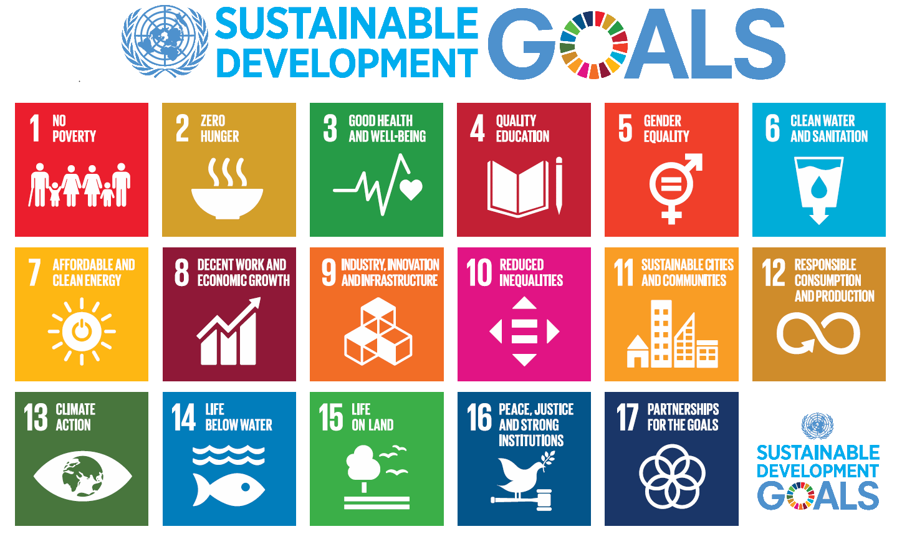

United Nations SDGs
#circularliving www.MyWaste.ie

Slide 3
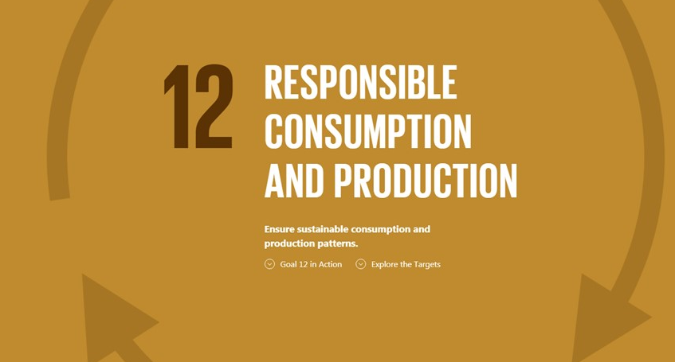

#circularliving www.MyWaste.ie

Slide 4

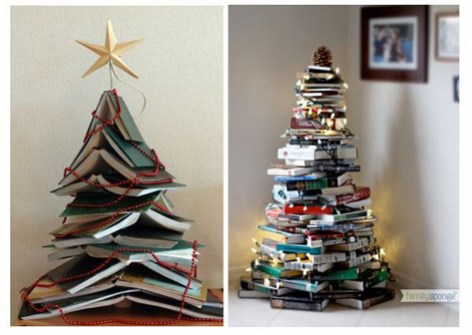
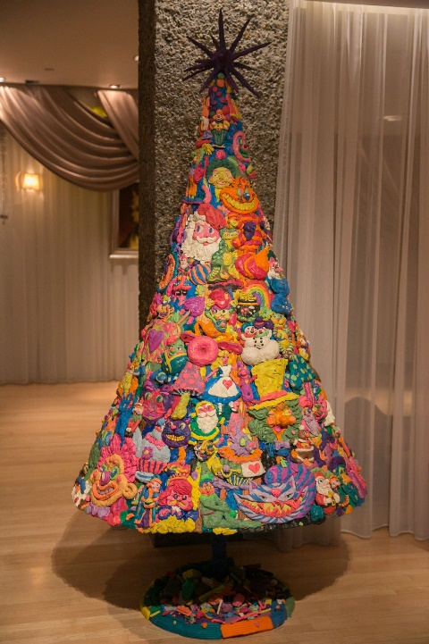
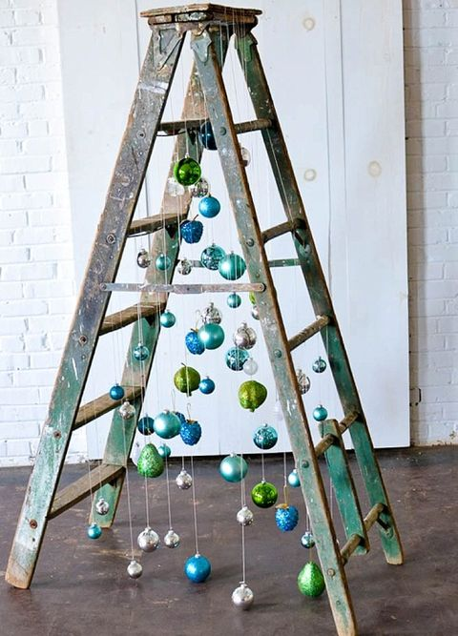
Ho Ho Ho! Imagination & Creativity
There are no limits on your creativity and imagination when it comes to minimising waste at Christmas
#circularliving www.MyWaste.ie

Slide 5
Ho Ho Ho! Embrace Circular Living
Make a list for gifts, shopping and stick to it!
Try gifting experiences not stuff. E.g.: concert or theatre tickets, book or magazine subscriptions.
Home edibles make fabulous gifts so get your creative chef hat on. E.g.: homemade jams or pickled vegetables or fruits.
Why not share party clothes with friends rather than buying something you might only wear once.
Remember, the key is to focus on thoughtful and meaningful gifts. Whether it's an experience, a homemade treat, or a shared item, the goal is to create lasting memories and reduce the emphasis on material possessions.
#circularliving www.MyWaste.ie

Slide 6
Ho Ho Ho! Think About The Christmas Tree
Fake Christmas trees are made of many types of material which generally makes them unsuitable for recycling.
Trees of this type should be reused over and over - 10+ years.
When no longer fit for purpose, fake Christmas trees should be placed in the general waste bin for disposal. (if it is WEEE then goes for WEEE recycling)
#circularliving www.MyWaste.ie

Slide 7
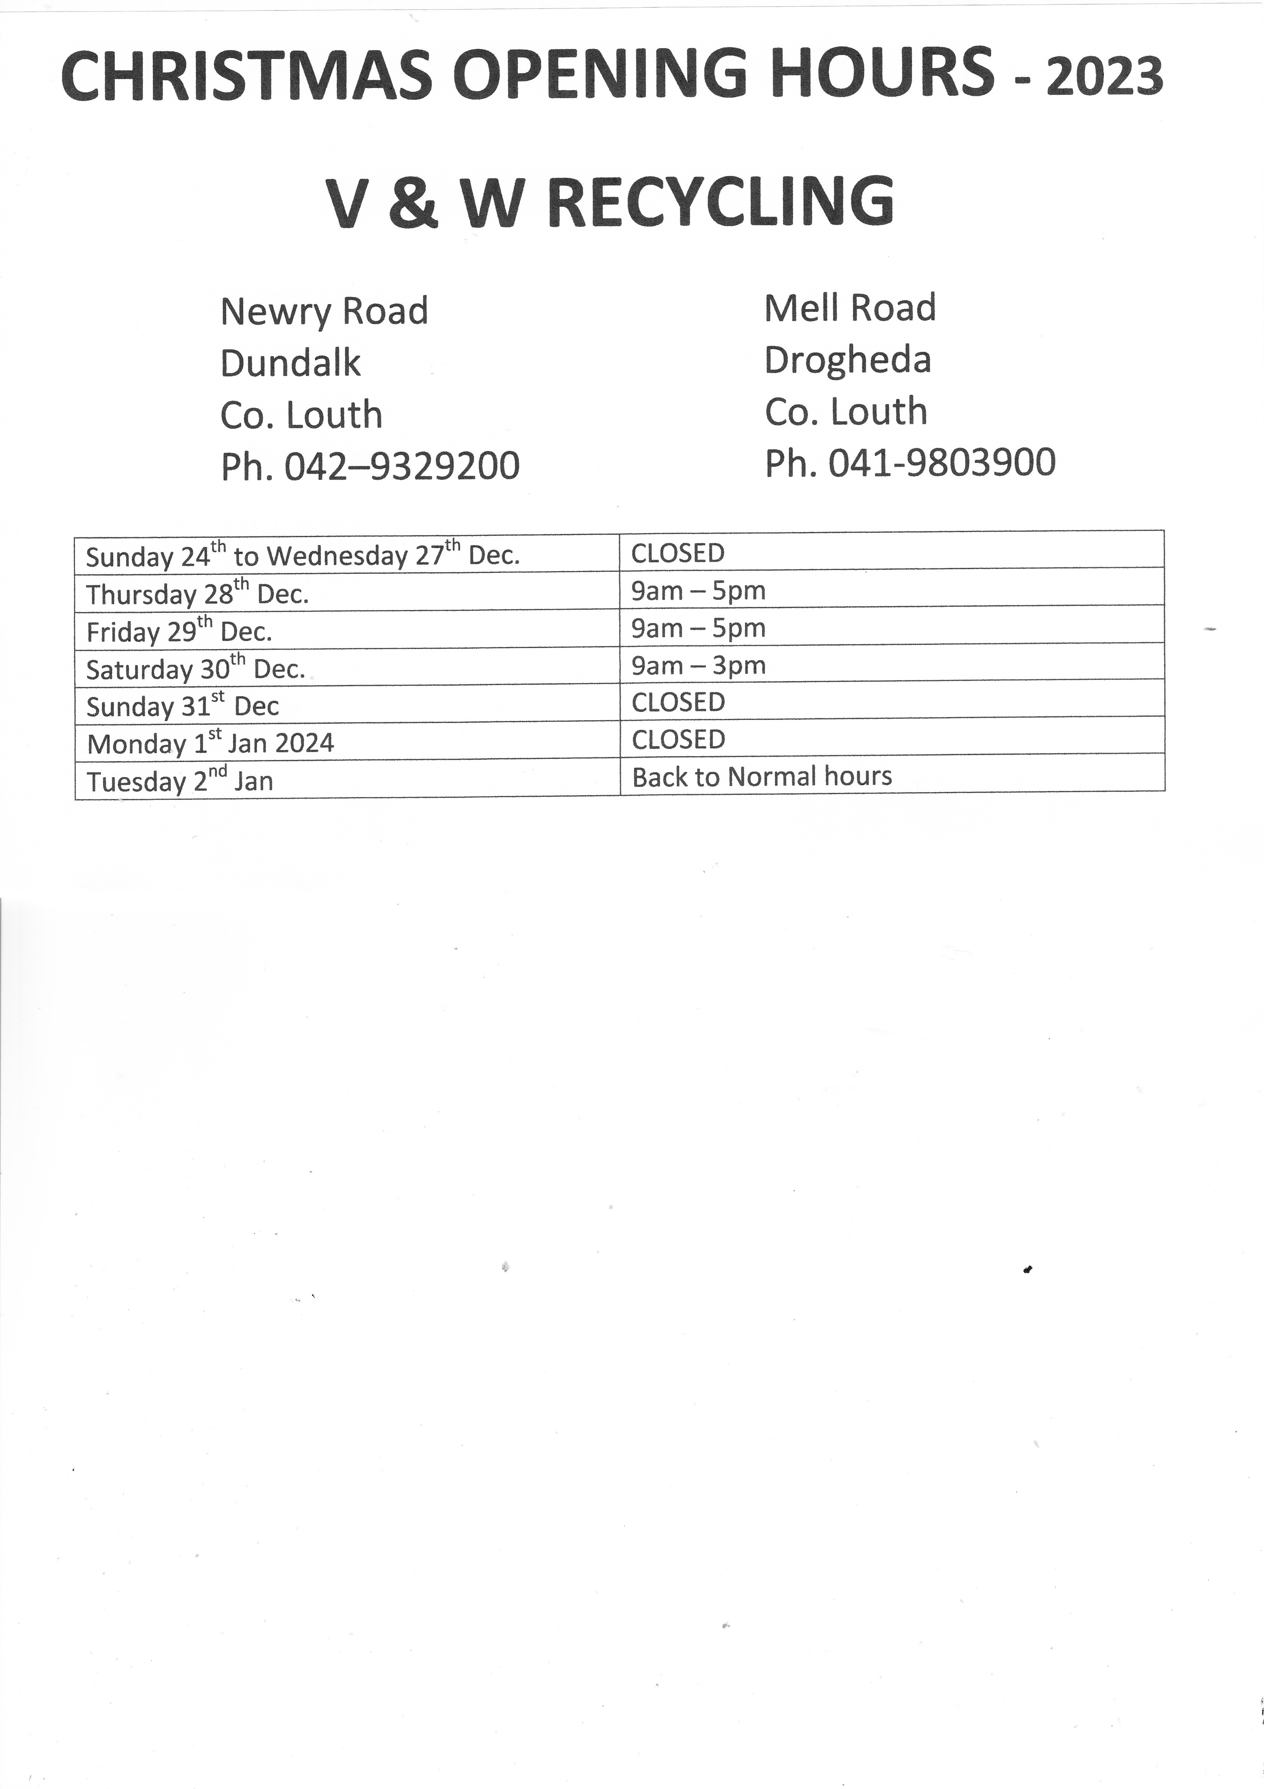

Ho Ho Ho! Think About The Christmas Tree
V&W Recycling Centres in Dundalk & Drogheda will accept Christmas Trees throughout 2024 for the usual €4 entrance fee.
Opening hours for the Dundalk & Drogheda Civic Amenity Centres in can be found at https://www.vandwrecycling.ie/
#circularliving www.MyWaste.ie

Slide 8
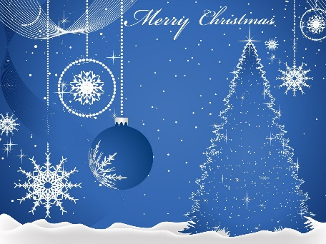
Ho Ho Ho! Think About Christmas Cards
Christmas cards are generally made of heavy paper or light card.
Most cards and their envelopes can be placed in the household recycle bin.
Remove
  embellishments such as ribbons
  film window from envelopes.
Use old cards for arts and crafts or gift tags.
#circularliving www.MyWaste.ie
#circularliving www.MyWaste.ie

Slide 9
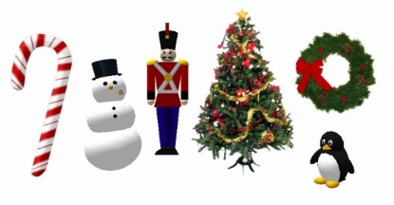
Ho Ho Ho! Think About Christmas Decorations
Many Christmas decorations are made of a multiple materials which makes them unsuitable for recycling.
Reuse your decorations each year or perhaps swap them with friends.
Old decorations made from paper, card or rigid plastic only- can be placed in the recycling bin.
If you are not sure what the decoration is made of or unsure if it is made of multiple materials, then place the item in the general waste bin.
If a decoration has a battery, remove the battery separately for recycling.
#circularliving www.MyWaste.ie

Slide 10
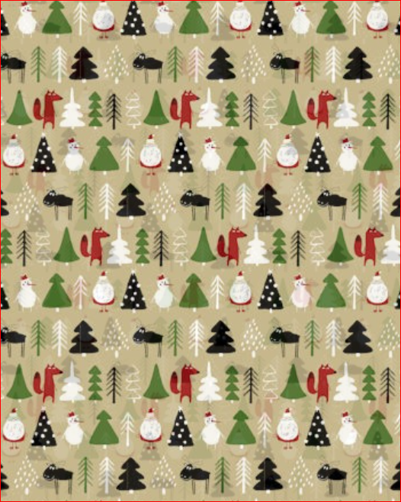

Ho Ho Ho! Think About Christmas Wrapping
Christmas decoration packaging is generally made of paper, card or soft plastics.
Paper, card and soft plastic packaging can be placed in the recycling bin.
Please make sure items are clean, dry and placed loosely in the bin.

Slide 11
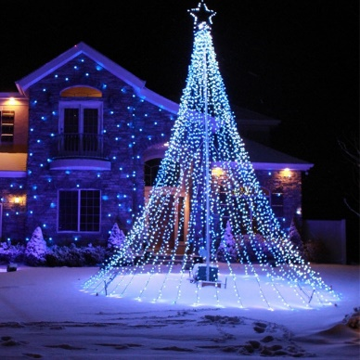

Ho Ho Ho! Think About WEEE
WEEE is a waste electrical item – anything powered by a battery or a plug.
This should be brought to a WEEE drop off recycling point or recycling centre site.
Electrical items generally contain hazardous components and therefore need to be disposed of correctly. This helps to conserve resources such as plastics, glass and metals that can be recovered for use again in industry.
Does it have a picture of a crossed-out wheelie bin on it?
#circularliving www.MyWaste.ie

Slide 12
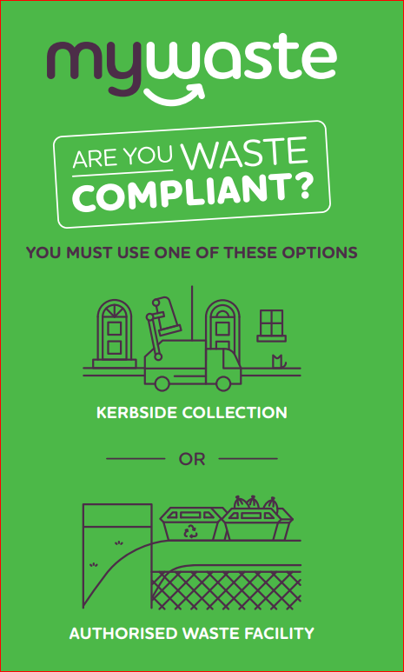
Ho Ho Ho! Think About Waste Segregation
Waste
Have a waste segregation collection system.
Ensure the waste generated is collected by a waste operator with a waste collection permit.
Present the waste with the correct waste in the correct bin.
Segregate your waste into food waste, dry recyclables & landfill waste.
Check changes to your bin collection days over the holidays.
Save gift bags & Christmas wrapping for reuse.
#circularliving www.MyWaste.ie

Slide 13


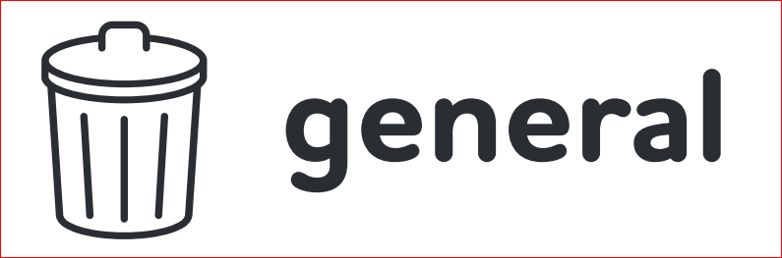


Ho Ho Ho! Think About Waste Segregation
Recycling
Food Waste
General Waste
Glass or
  Glass (Bring Bank)
#circularliving www.MyWaste.ie

Slide 14
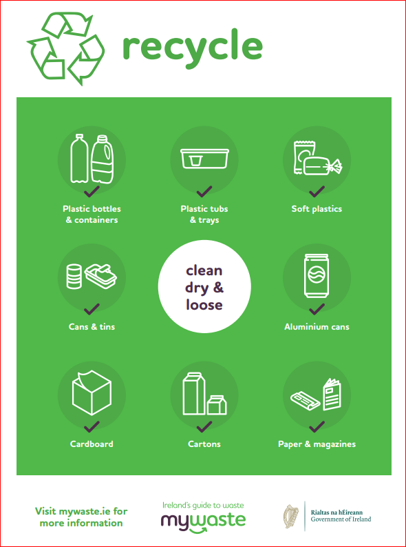
Ho Ho Ho! Think About Waste Segregation
Clean
Dry
Loose
#circularliving www.MyWaste.ie

Slide 15
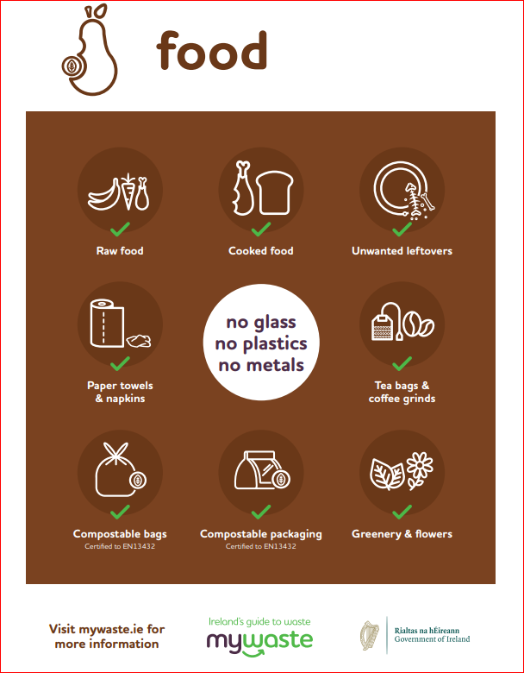
Ho Ho Ho! Think About Waste Segregation
No Glass
No Plastics
No Metals
#circularliving www.MyWaste.ie

Slide 16
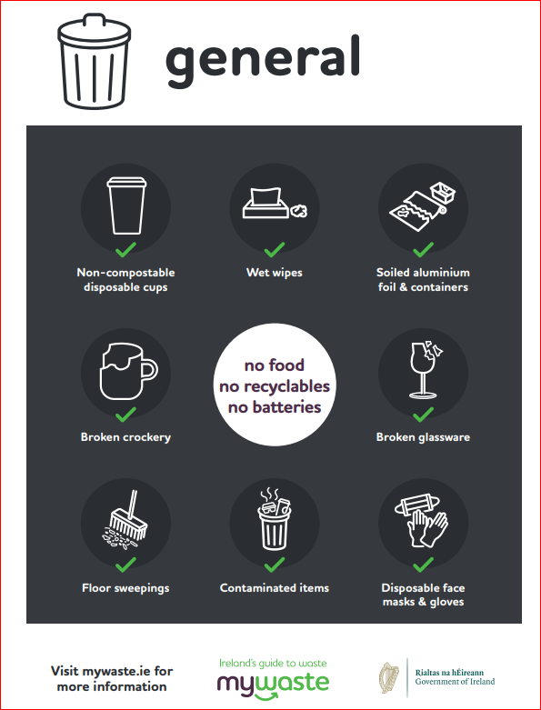

Ho Ho Ho! Think About Waste Segregation
No food
No recyclables
No batteries
No vapes
#circularliving www.MyWaste.ie

Slide 17

Ho Ho Ho! Think About Waste Segregation
No crockery
No drinking glasses
No perfume bottles
2
2
#circularliving www.MyWaste.ie

Slide 18

Ho Ho Ho! Think About Food Waste
Make space in your freezer and cupboards in late Nov/early Dec.
Plan your Christmas menu. Make a list and stick to it.
If there is something on your Christmas menu that is always left over – don’t serve it this year.
Use serving bowls. Leftovers can then be reused.
Research luscious leftover recipes to use over the holiday season.
Drink tap rather than bottled water – it's cheaper & creates less waste.
Make use of your freezer for leftover sauces, gravies, bread & veg.
Don’t overstock on basics. Supermarkets and local shops reopen quickly after Christmas.
#circularliving www.MyWaste.ie

Slide 19
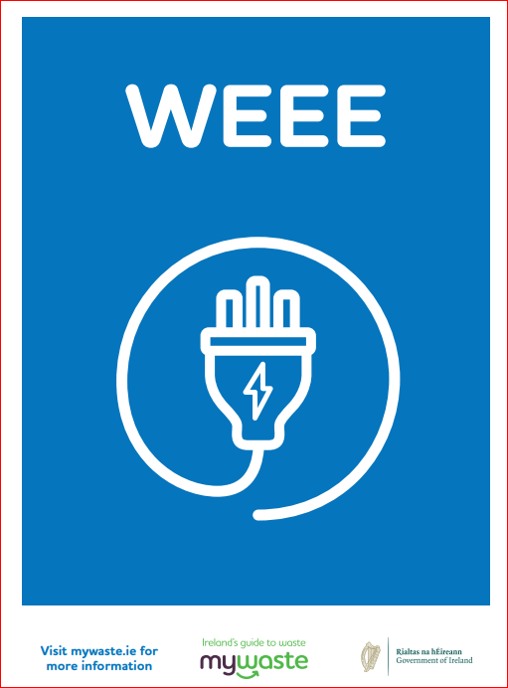

Ho Ho Ho! Think About Waste Segregation
Waste WEEE – anything powered by a battery or plug
#circularliving www.MyWaste.ie

Slide 20

Ho Ho Ho! Think About Waste Segregation
Waste batteries can be returned to any shop selling batteries
Louth County Council also has battery recycling collection points in our libraries.
#EGLA #EGLALimerick2020
#circularliving www.MyWaste.ie

Slide 21
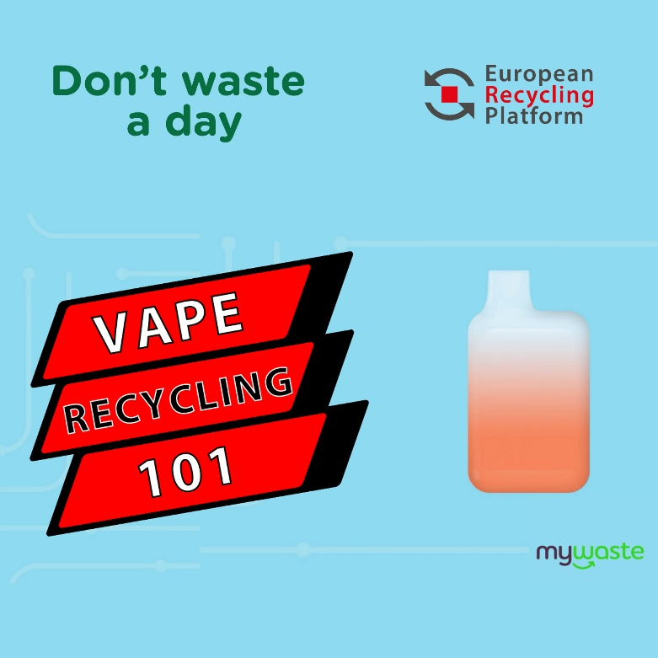
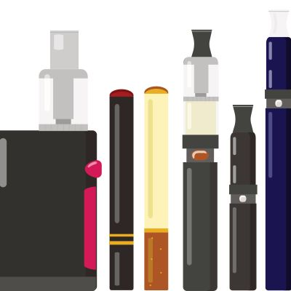
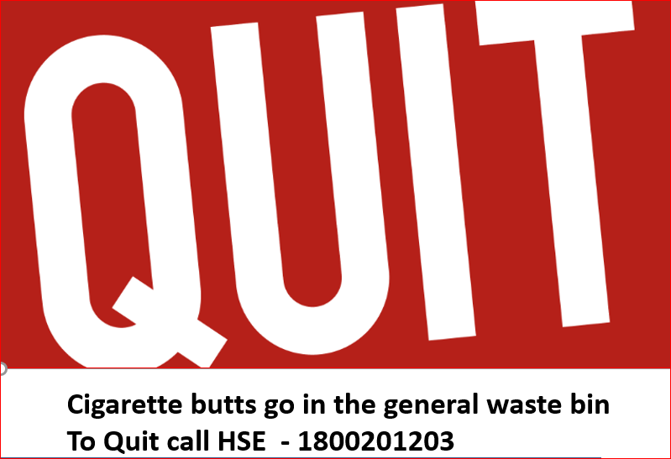
Ho Ho Ho! Think About Waste Segregation
=
#circularliving www.MyWaste.ie

Slide 22
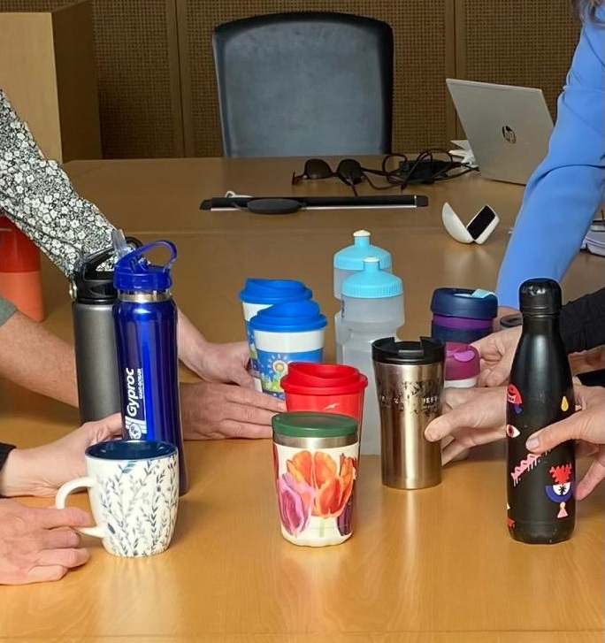

Ho Ho Ho! Say no to Single Use
Use a reusable cup
Remember to bring it with you
Give a reusable cup as a gift
Encourage business to accept reusable cups or join a reusable cup deposit and return scheme
No
to Single Use Cups
No
to Single Use Cups
#circularliving www.MyWaste.ie

Slide 23
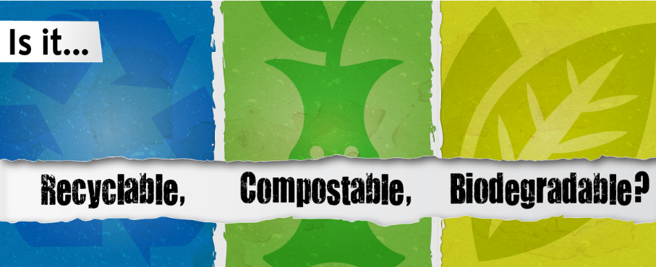

Biodegradable and Compostable Alternatives come with a Health Warning:
Ho Ho Ho! Say no to Single Use
Biodegradable could take hundreds of years.
Composted items generally do not make their way to brown bins or compost heaps – so they may be compostable, but they often end up in the general waste bin.
#circularliving www.MyWaste.ie

Slide 24
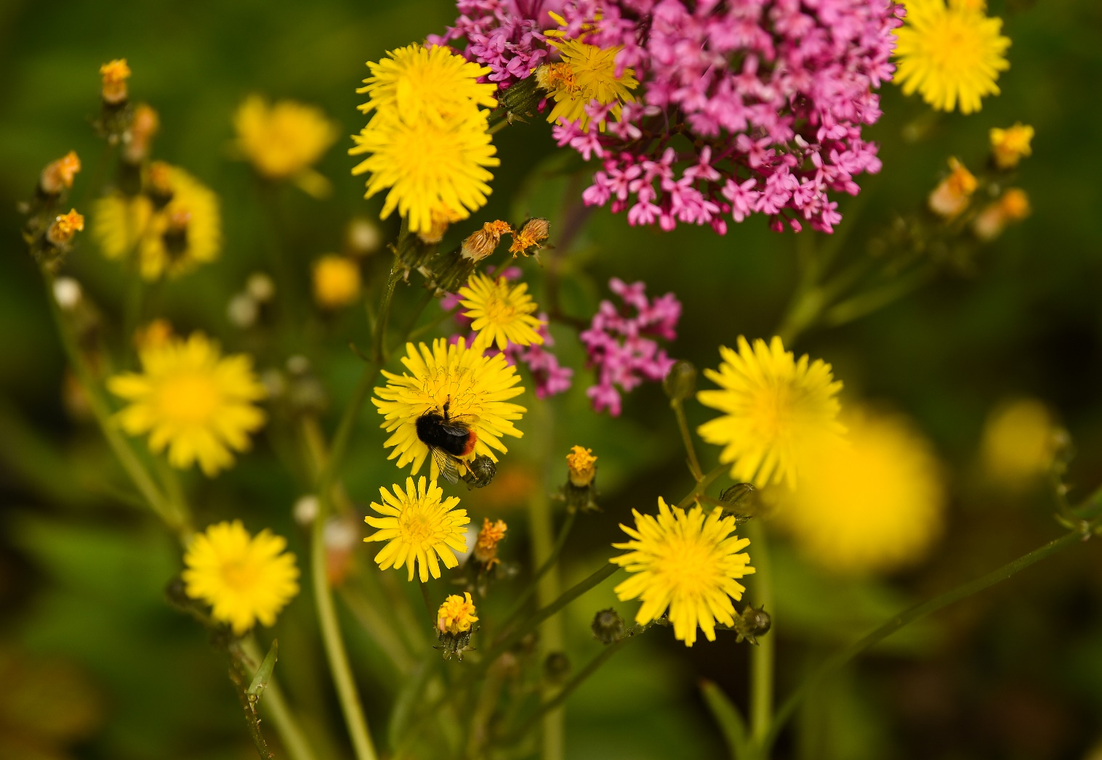

Ho Ho Ho! Connect with Nature
Plan Pollinator Planting for 2024
Get out into the great outdoors and build an appetite for the big dinner.
Feed the birds.
Visit your local park.
Participate in Birdwatch Ireland’s winter Garden Bird Survey. www.birdwatchireland.ie for details.
Find out more about your local river.
Fairtrade – Limerick is a Fairtrade City - Trade not aid – fair price in producer’s country – community fund – no child labour – women allowed own land and businesses – organic certification often included – health and safety for workers - Audited by FLO Cert www.flocert.net
#circularliving www.MyWaste.ie

Slide 25
Ho Ho Ho! Think About Consumption
Ho Ho Ho! Resolutions for 2024
Love Louth Don’t Litter.
Use a reusable cup & water bottle.
Support your local Tidy Towns group.
Carry a pooper scooper/bag. Use any bag and any public bin!
Bin your gum when it's done. www.gumlittertaskforce.ie
Don’t drop cigarette butts- they are plastic- bin them.
Plan your participation in National Spring Clean in 2024.
Have a household waste collection service.
Segregate your waste correctly into the correct bins.
Use the national deposit and return scheme being introduced in 2024.
Embrace circular living.
#circularliving www.MyWaste.ie

Slide 26
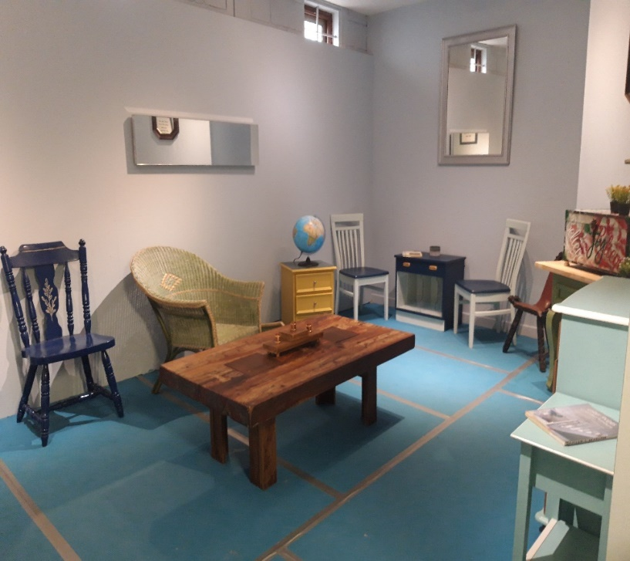
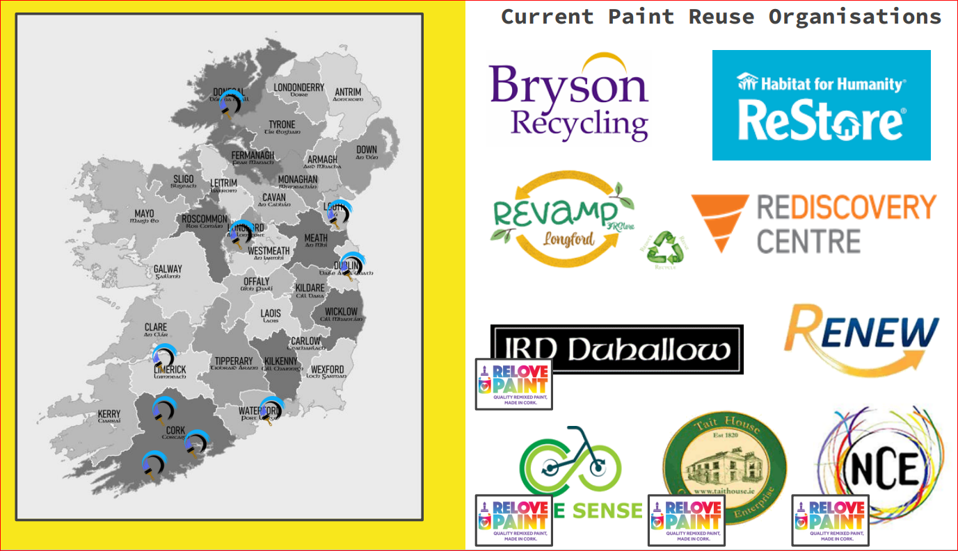
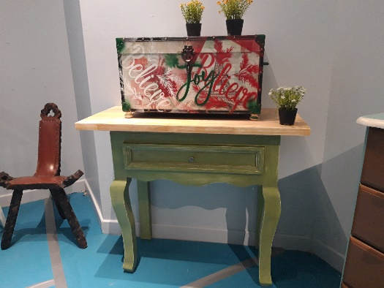

Ho Ho Ho! Think about Relove Paint in 2024
#circularliving www.MyWaste.ie

Slide 27
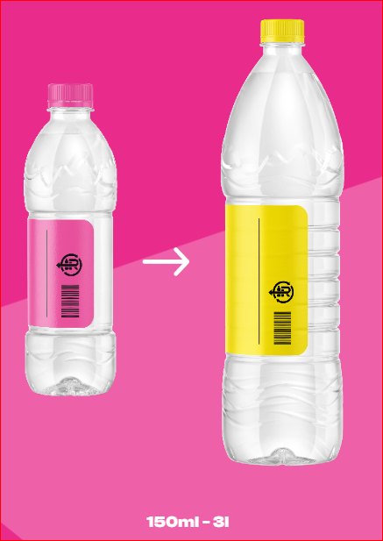
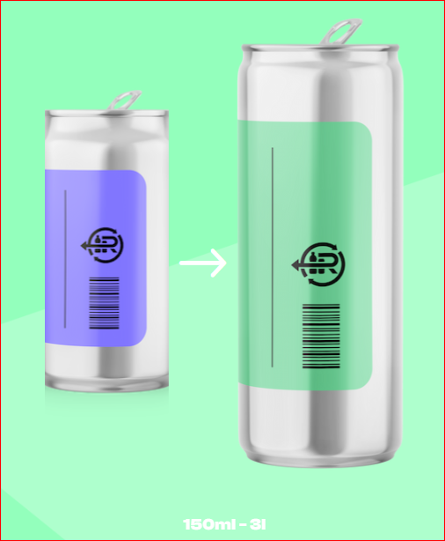
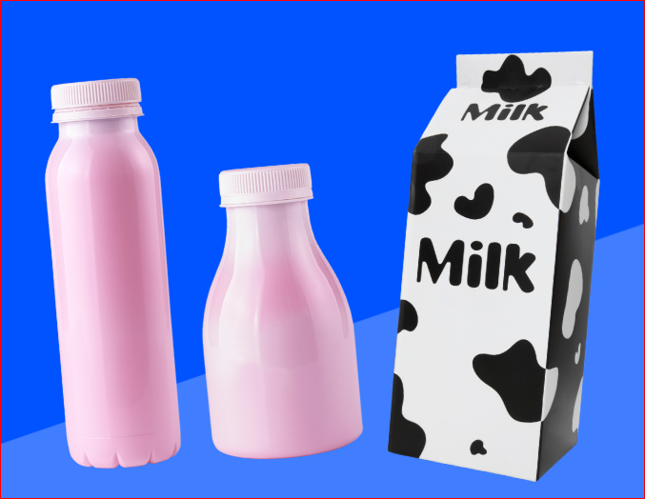

Ho Ho Ho! Think about Deposit & Return in 2024
No Dairy


Barcoded Plastic bottles + Drinks cans
#circularliving www.MyWaste.ie

Slide 28
Ho Ho Ho! Think about Circular Living / Economy
Rethink
Reduce
Reuse
Recycle
Repair
Refurbish
Redesign
Reimagine
#circularliving www.MyWaste.ie

Slide 29
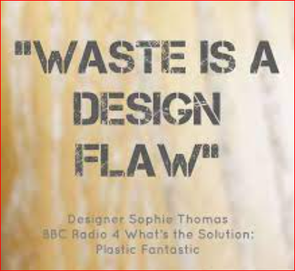

Waste is a Design Flaw
Waste is not a natural occurrence; it is a design flaw. Our current models of production and consumption are linear, leading to the overutilization of resources, excessive waste generation, and detrimental environmental consequences. To create a sustainable future, we need to shift from linear to circular models. The concept of a circular economy aims to minimise waste by designing products and systems that prioritise reuse, repair, and recycling.
“Carlota-Ortega-de-Mateo” Sustainability & CSR consultant
#circularliving www.MyWaste.ie

Slide 30

Louth County Council wishes you a peaceful & sustainable Christmas
Paula Gribben, Environment Awareness Officer
042 -9324317 community@louthcoco.ie
#circularliving www.MyWaste.ie

